Slide 1
11.1 Empirical Rule

Slide 2
60 | 61 | 63 | 64 | 70 | 72 | 75 | 78 | 79
Q2
Q1
Q3
There are two commonly-accepted ways to do this …
Option: Take the mean
$$Q_{1}=\frac{61+63}{2}=62$$
$$Q_{3}=\frac{75+78}{2}=76.5$$
Option: Choose the bigger one
$$Q_{1}=63$$
$$Q_{3}=78$$

Slide 3
What you will learn
Calculate probabilities using normal distributions and the Empirical Rule
Recognize data sets that are normal

Slide 4
Normal Distributions
Graph is a symmetric, bell-shaped curve called the normal curve.
We call the distribution “normal” because of how commonly it occurs!
Because it’s so common, people have studied it very closely.

Slide 5
What makes a normal distribution “normal?”
This is something mathematicians are still working to fully understand!
We have noticed a mathematical fact:
If you measure multiple things, each with a different distribution …
… and then add the data together (or, averaging the data works too) …
… the sum (or average) will be a normal distribution!
What to Expect when Throwing Dice and Adding Them Up | by Juan Luis Ruiz-Tagle | Cantor’s Paradise
This fact is called the “Central Limit Theorem”

Slide 6
What makes a normal distribution “normal?”
This principle works backwards too: if the thing you’re measuring is the sum of several factors, each factor with its own distribution, then you will measure a normal distribution!
Example: What are some factors that affect how tall somebody is?

Slide 13
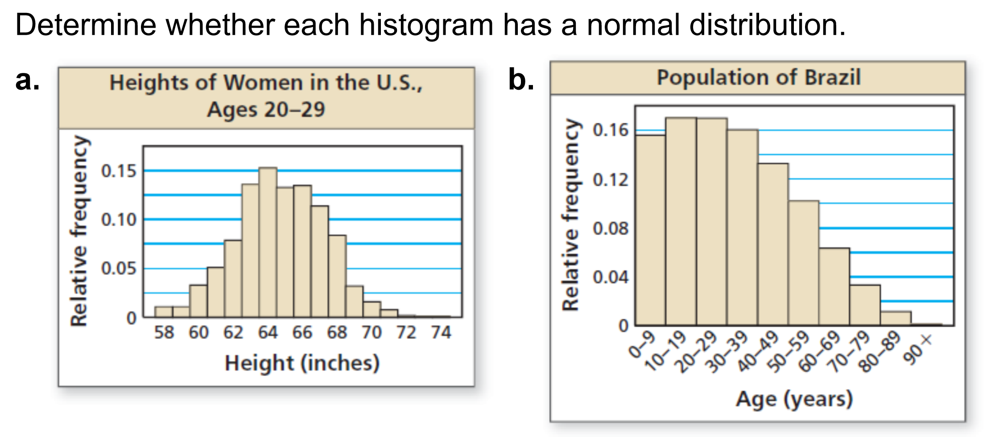
The histogram is bell-shaped and fairly symmetric. So, the histogram has an approximately normal distribution.
The histogram is skewed right. So, the histogram does not have a normal distribution, and you cannot use a normal distribution to interpret the histogram.

Slide 14
Homework: Textbook page 600; 3 – 17 odd, 19, 20

